Slide 1

NRI Institute of Science And Technology
Submitted to:
Mr. Anurag Srivastava
Head of Department,
Computer Science & Engineering.
Presented by:
Rahul Singh
(0115CS191079)

Slide 2
Index:
Project name.
Problem statement.
Planned system.
Existing system.
Existing systems vs Proposed system.
Team members

Slide 3

INCOME TAX CALCULATOR

Slide 4
What is tax?
Taxes are mandatory contributions imposed on an individual or a company by any government entity.
These tax revenues finance the government expenditures like infrastructural development and social security
There are several types of taxes, like income tax, property tax, sales tax, etc.

Slide 5
Income Tax
Income tax is a type of tax that governments impose on any income generated by businesses and individuals.
It is used to fund public services like and pay governmental obligations.
Personal income tax is a type of income tax that is imposed on an individual’s wages, salaries and other types of incomes.
Business income tax apply to corporations, partnerships, small businesses and people who are self employed.

Slide 6

Problems:
A Majority of our population do not know about taxes.
Either they do not know how to pay taxes or are not in the taxable population
And in our education system, there is no practical subject discussing financial literacy and taxation.

Slide 7
EDUCATION
According to financialexpress.com Only 27% Indians are financially literate.
23%
67%
Financially Literate
Financially
Illiterate

Slide 8
TAX PAYERS
According to Bloomberg, less than 10% of Indians pay their taxes, most are unaware or simply do not fall under taxable income.
>90%
<10%
Non-Tax Payers
Tax Payers

Slide 9
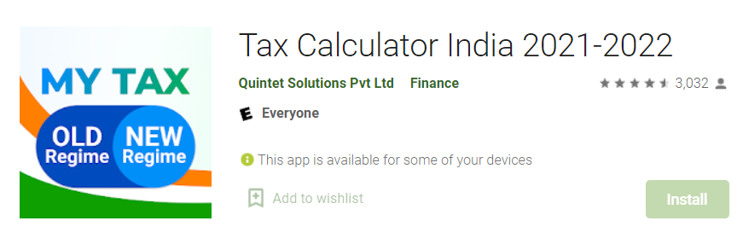
Existing System

Slide 10
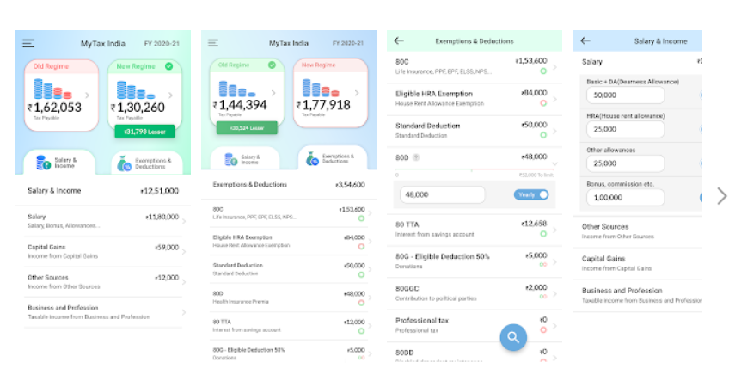

Slide 11
Planned System
A service which aids people in calculating their required taxes and on how to cut down on taxes using deductions.
Educating people about financial literacy, while providing adequate content and sources to do so.

Slide 12

Deductions:
A tax deduction is a deduction that lowers a person’s or an organization’s tax liability by lowering their Taxable income.
Tax deduction refers to claims made to reduce your taxable income, arising from various investments and expenses incurred by a taxpayer.

Slide 13
COMPARISON
EXISTING SYSTEM
PROPOSED SYSTEM
This only calculates the tax required on based of our incomes and revenues.
We don’t know how the tax is calculated and the concepts behind it.
There are no suggestions on deductions.
This will be focused more on gaining a financial sense rather than just calculating it.
Our system is planned to make taxation easier for our busy generation.
It is planned to not only calculate taxes but also suggest us to pay minimum taxes in a legal way, Via Deductions.

Slide 14
Roles :-
Rahul Singh(0115CS191079),
- Lead developer , Back-End development and
UI/UX design.
- Front-End development , Planning and Modeling.

